Slide 1
Xamarin Community Toolkit

Slide 3
Views

Slide 4
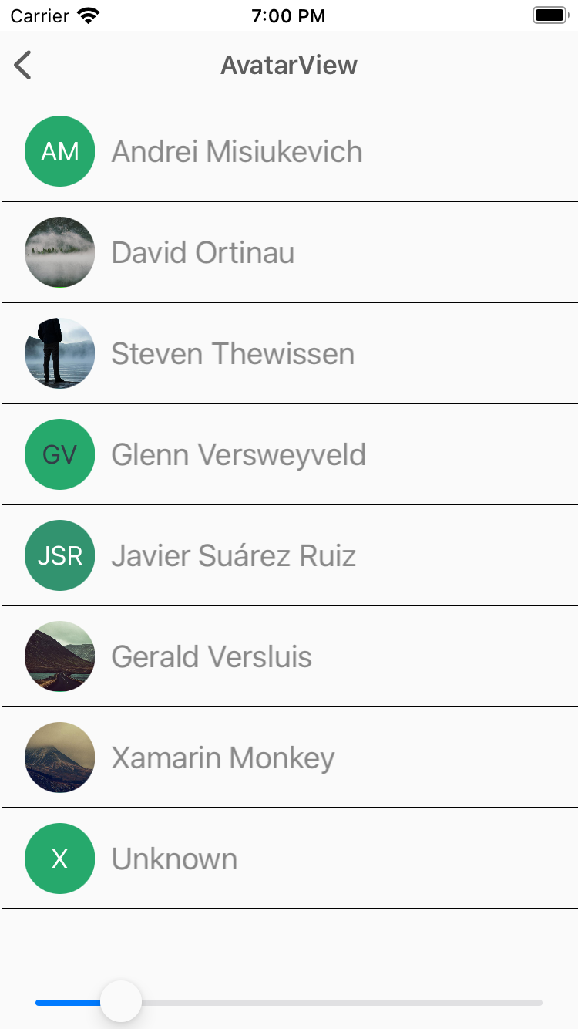
AvatarView
The AvatarView represents a user's name by using the initials and a generated background color.
<xct:AvatarView
ColorTheme="{x:Static xct:ColorTheme.Jungle}"
FontSize="Medium”>
<xct:AvatarView.Source>
<UriImageSource Uri="{Binding Source}" />
</xct:AvatarView.Source>
</xct:AvatarView>

Slide 5
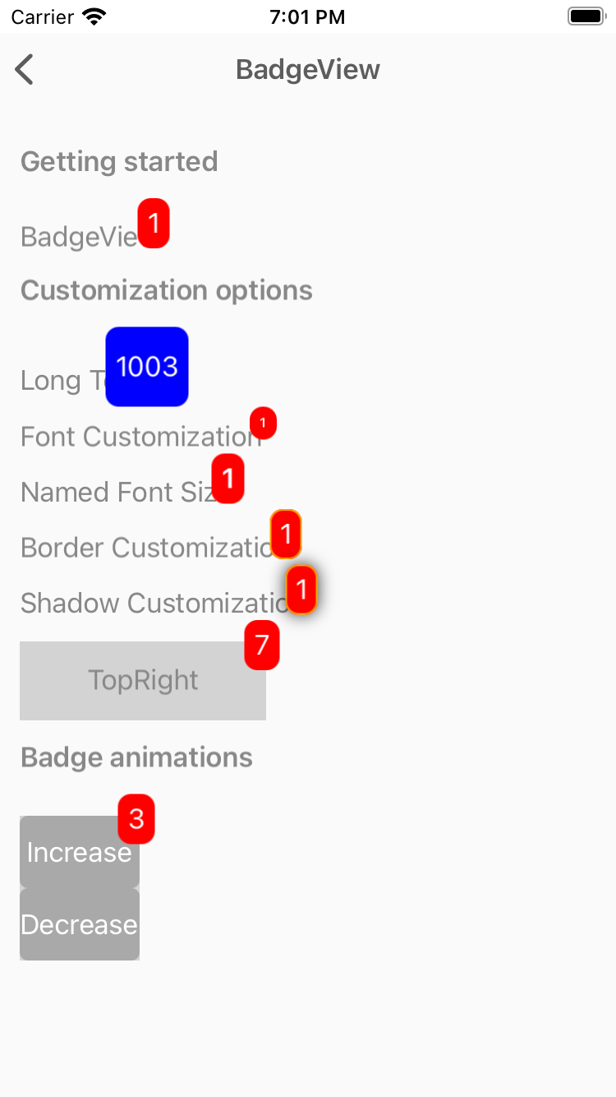
BadgeView
View used to used to notify users notifications, or status of something.
<xct:BadgeView
BackgroundColor="Red"
TextColor="White"
Text="1">
<Label
Text="BadgeView"/>
</xct:BadgeView>

Slide 6
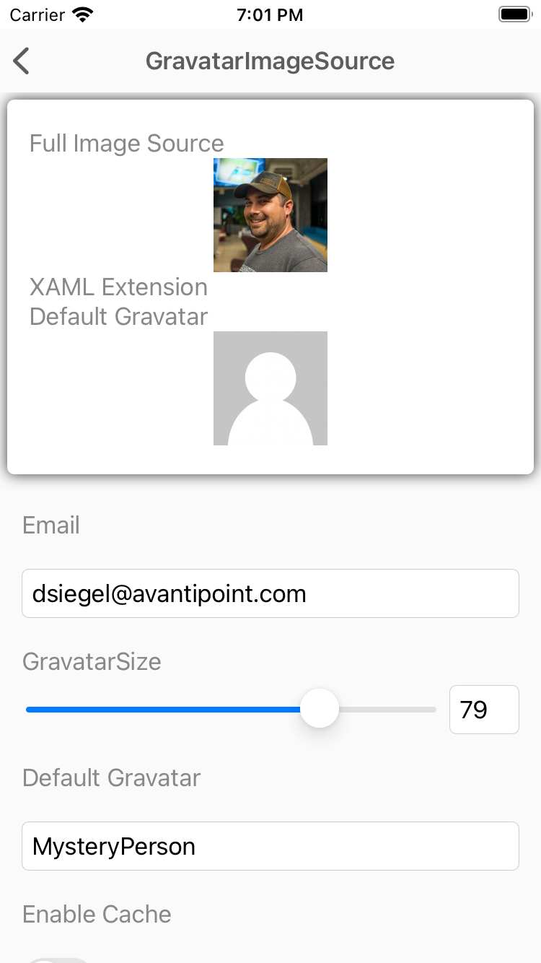
GravatarImageSource
The GravatarImageSource allows you to easily utilize a users Gravatar image from Gravatar.com using nothing but their email address.
<Image>
<Image.Source>
<xct:GravatarImageSource
Email="{Binding Email}"
Size="{Binding Size}"
CachingEnabled="{Binding EnableCache}" />
</Image.Source>
</Image>

Slide 7
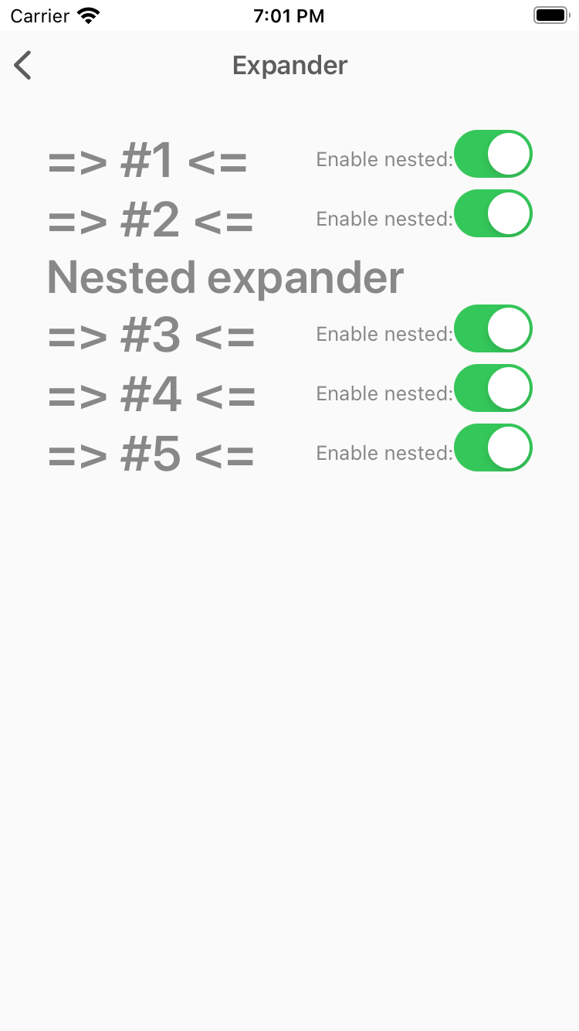
Expander
The Expander control provides an expandable container to host any content.
<xct:Expander IsEnabled="{Binding IsEnabled}">
<xct:Expander.Header>
<Label Text="Nested expander" FontSize="30" FontAttributes="Bold"/>
</xct:Expander.Header>
<xct:Expander.ContentTemplate>
<DataTemplate>
<StackLayout Spacing="0" Margin="10" Padding="1" BackgroundColor="Black">
<BoxView HeightRequest="50" Color="White" />
<BoxView HeightRequest="50" Color="Red" />
<BoxView HeightRequest="50" Color="White" />
</StackLayout>
</DataTemplate>
</xct:Expander.ContentTemplate>
</xct:Expander>

Slide 8
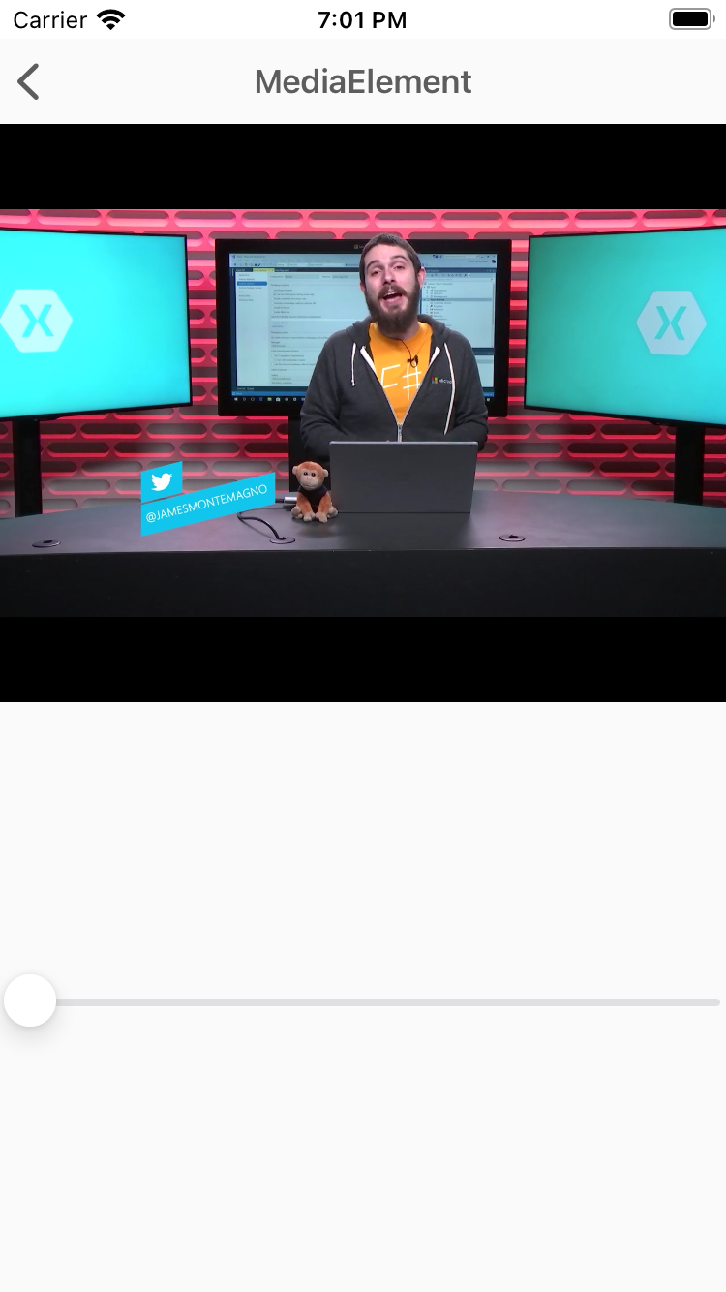
MediaElement
MediaElement is a view for playing video and audio.
<xct:MediaElement
x:Name="mediaElement"
Source="https://sec.ch9.ms/ch9/5d93/a1eab4bf-3288-4faf-81c4-294402a85d93/XamarinShow_mid.mp4"
ShowsPlaybackControls="True"
MediaOpened="OnMediaOpened"
MediaFailed="OnMediaFailed"
MediaEnded="OnMediaEnded"
SeekCompleted="OnSeekCompleted" />

Slide 9
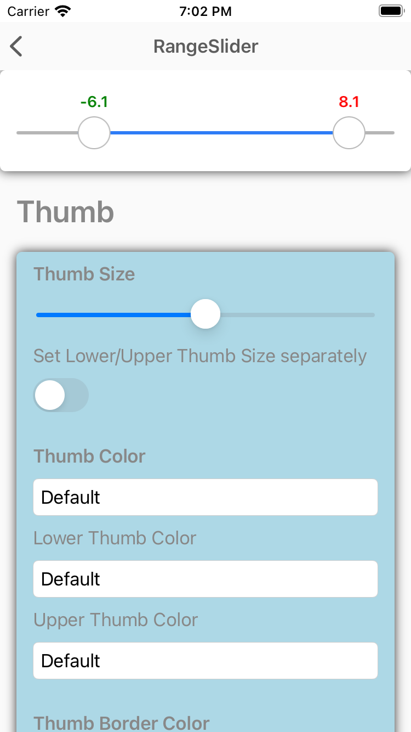
RangeSlider
The RangeSlider is a slider with two thumbs allowing to select numeric ranges.
<xct:RangeSlider
x:Name="RangeSlider"
MaximumValue="10"
MinimumValue="-10"
StepValue="0.01"
LowerValue="-10"
UpperValue="10”>
<xct:RangeSlider.LowerThumbView>
<Label Text="L" VerticalTextAlignment="Center" HorizontalTextAlignment="Center" IsVisible="{Binding IsToggled, Source={x:Reference LowerThumbViewSwitch}}" />
</xct:RangeSlider.LowerThumbView>
<xct:RangeSlider.UpperThumbView>
<Label Text="U" VerticalTextAlignment="Center" HorizontalTextAlignment="Center" IsVisible="{Binding IsToggled, Source={x:Reference UpperThumbViewSwitch}}" />
</xct:RangeSlider.UpperThumbView>
</xct:RangeSlider>

Slide 10
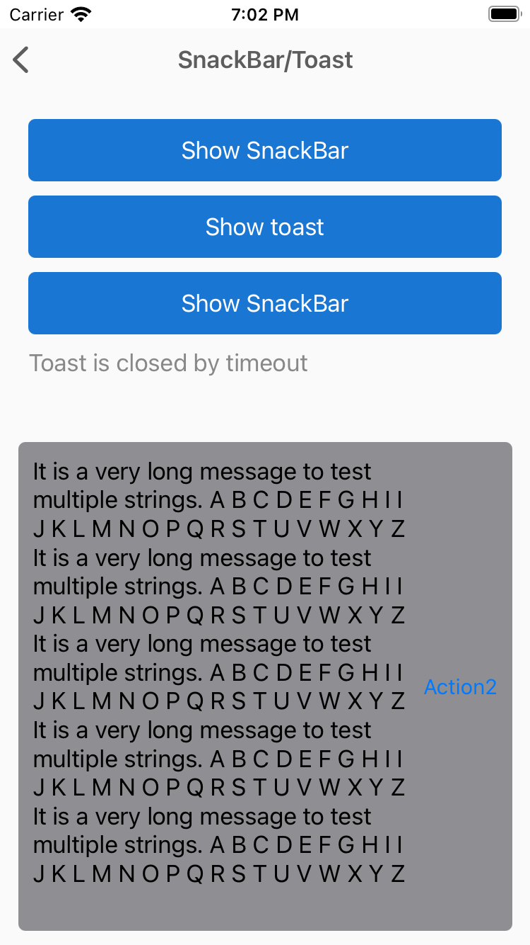
SnackBar
Show SnackBar, Toast etc.
var messageOptions = new MessageOptions
{
Message = GenerateLongText(5)
};
var actionOptions = new List<SnackBarActionOptions>
{
new SnackBarActionOptions
{
Text = "Action1",
Action = () =>
{
Debug.WriteLine("1");
return Task.CompletedTask;
}
},
new SnackBarActionOptions
{
Text = "Action2",
Action = () =>
{
Debug.WriteLine("2");
return Task.CompletedTask;
}
}
};
var options = new SnackBarOptions
{
MessageOptions = messageOptions,
Duration = TimeSpan.FromMilliseconds(5000),
Actions = actionOptions
};
var result = await this.DisplaySnackBarAsync(options);

Slide 11
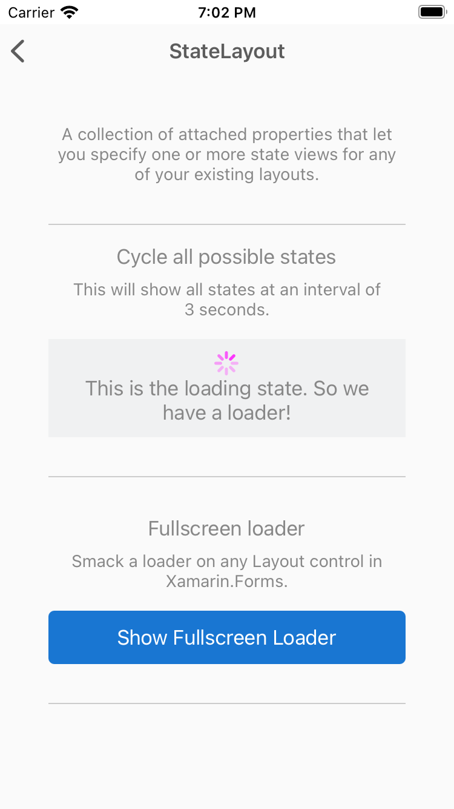
StateLayout
A collection of attached properties that let you specify one or more state views for any of your existing layouts.
<xct:StateLayout.StateViews>
<xct:StateView StateKey="Loading" BackgroundColor="White" VerticalOptions="FillAndExpand">
<StackLayout VerticalOptions="Center" HorizontalOptions="Center">
<ActivityIndicator Color="#1abc9c" IsRunning="{Binding MainState, Converter={StaticResource StateToBooleanConverter}, ConverterParameter={x:Static xct:LayoutState.Loading}}" />
<Label Text="Loading..." HorizontalOptions="Center" />
</StackLayout>
</xct:StateView>
</xct:StateLayout.StateViews>

Slide 12
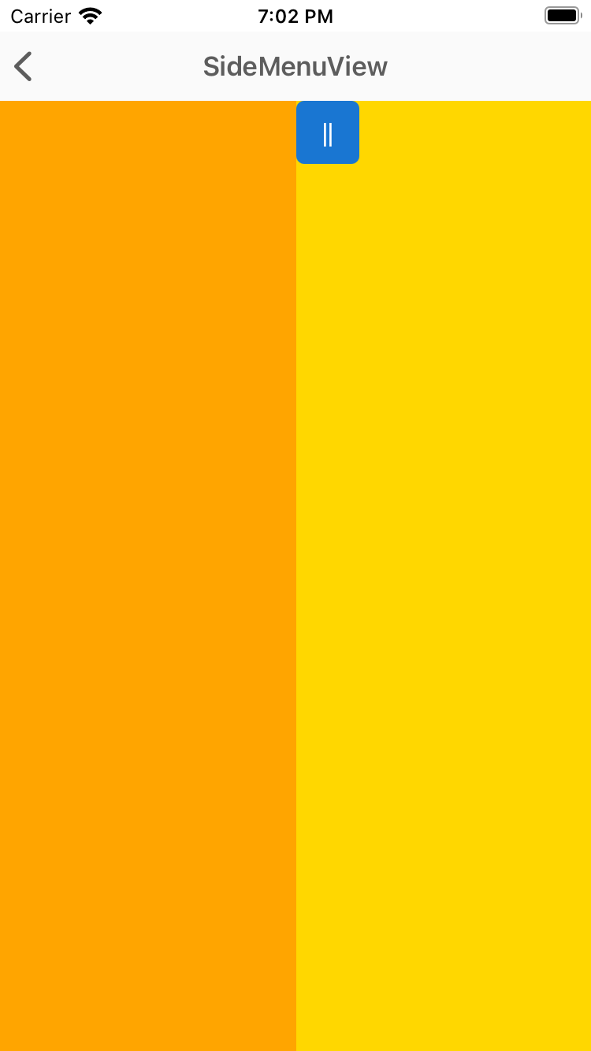
SideMenuView
SideMenuView is a simple and flexible Right/Left menu control.
<xct:SideMenuView x:Name="SideMenuView">
<!-- MainView -->
<StackLayout
Orientation="Horizontal"
BackgroundColor="Gold">
<Button Style="{StaticResource BaseMenuButtonStyle}"
Clicked="OnLeftButtonClicked" />
<Button Style="{StaticResource BaseMenuButtonStyle}"
HorizontalOptions="EndAndExpand"
Clicked="OnRightButtonClicked" />
</StackLayout>
<!-- LeftMenu -->
<BoxView
BackgroundColor="Orange"
xct:SideMenuView.Position="LeftMenu"
xct:SideMenuView.MenuWidthPercentage=".5" />
<!-- RightMenu -->
<BoxView
BackgroundColor="LightGreen"
xct:SideMenuView.Position="RightMenu"
xct:SideMenuView.MenuWidthPercentage=".3" />
</xct:SideMenuView>

Slide 13
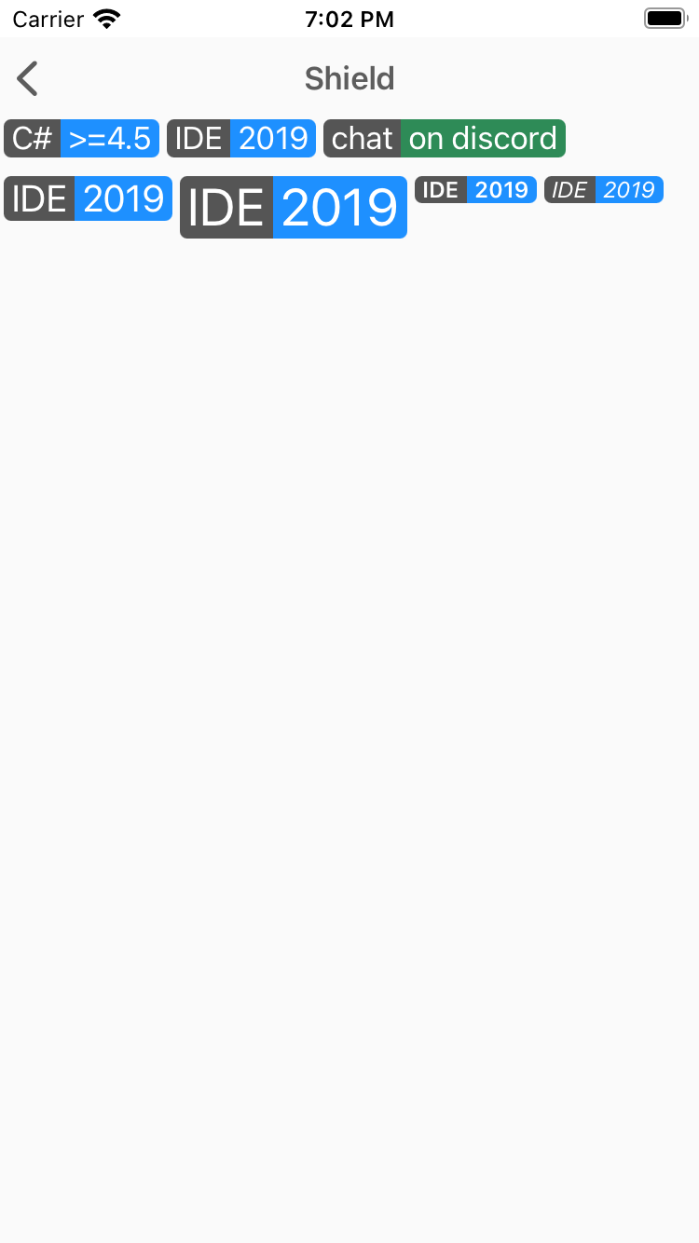
Shield
Shields can show some status information or call-to-action in a badge-like way.
<xct:Shield
Subject="IDE"
Status="2019"
Color="DodgerBlue"
TextColor="White"
Margin="2,0" />

Slide 14
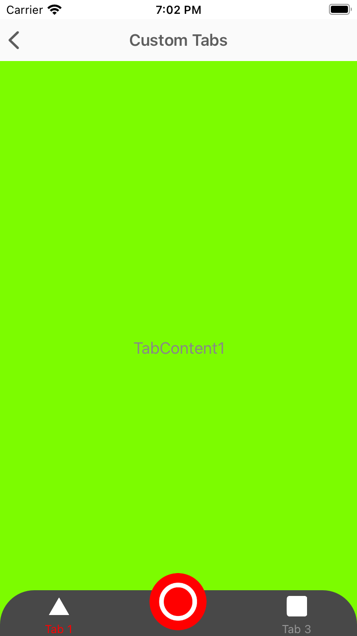
TabView
Shields can show some status information or call-to-action in a badge-like way.
<xct:TabView
TabStripPlacement="Bottom"
TabStripBackgroundColor="Blue"
TabStripHeight="60"
TabIndicatorColor="Yellow"
TabContentBackgroundColor="Yellow">
<xct:TabViewItem
Icon="triangle.png"
Text="Tab 1"
TextColor="White"
TextColorSelected="Yellow"
FontSize="12">
<Grid
BackgroundColor="Gray">
<Label
HorizontalOptions="Center"
VerticalOptions="Center"
Text="TabContent1" />
</Grid>
</xct:TabViewItem>
<xct:TabViewItem
Icon="circle.png"
Text="Tab 2"
TextColor="White"
TextColorSelected="Yellow"
FontSize="12">
<Grid>
<Label
HorizontalOptions="Center"
VerticalOptions="Center"
Text="TabContent2" />
</Grid>
</xct:TabViewItem>
</xct:TabView>

Slide 15
DEMO: Let's take a look at the controls

Slide 16
Preguntas & Respuestas

Slide 17


